Slide 1

Predicting customer buying behaviour

Slide 2
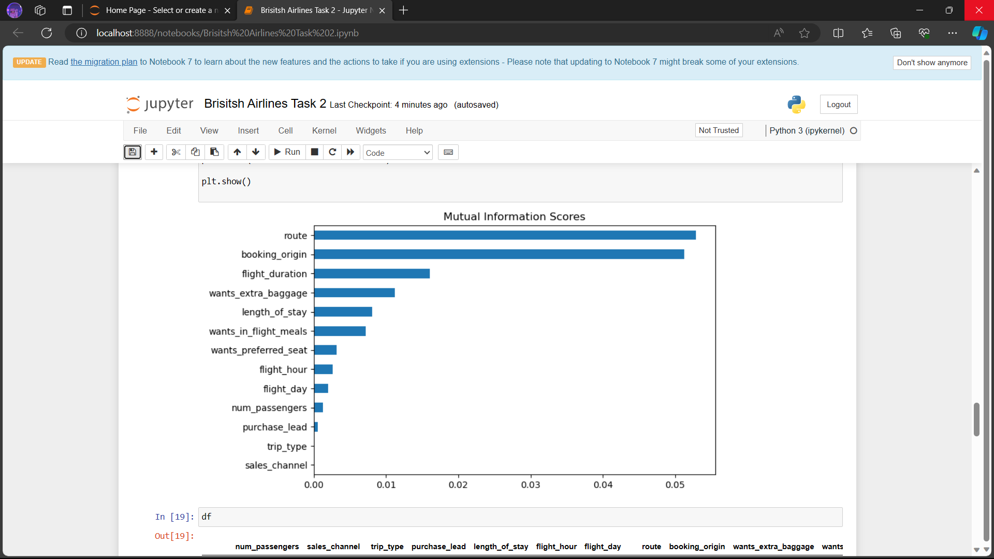
We have trained the data set with Random forest classifier model and received:
ACCURACY of the model : 84.66
AUC score of the model : 0.534
I have used all the features given in datset to predict customers buying behaviour.

